Slide 1





OUR EVENTS YEAR 2023

Slide 2
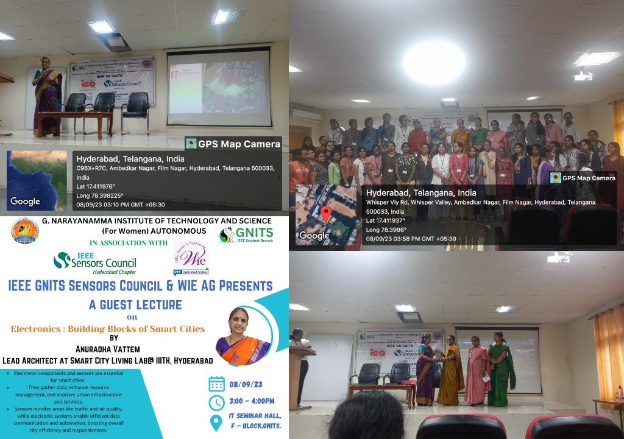

Slide 3
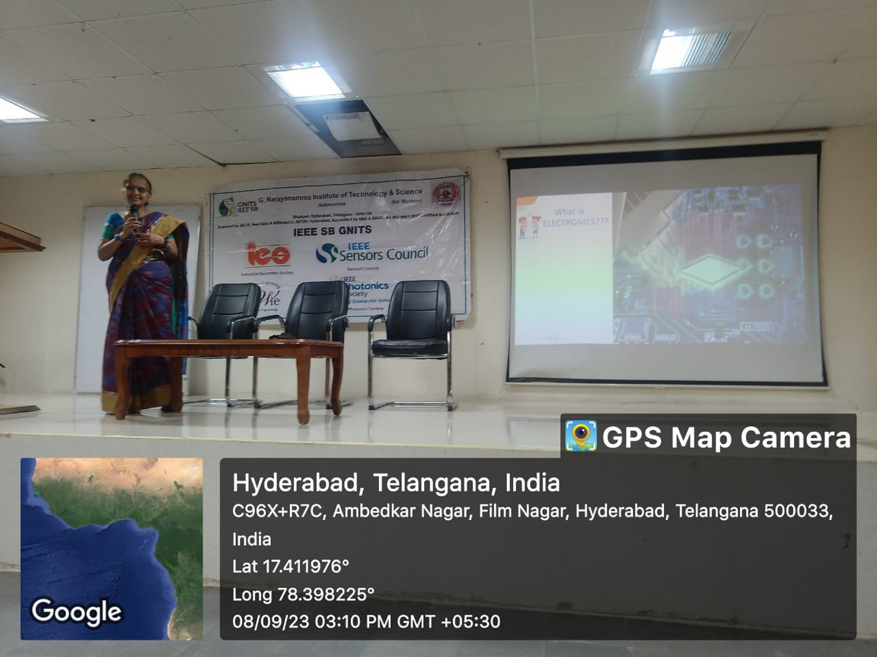

Slide 4


Slide 5
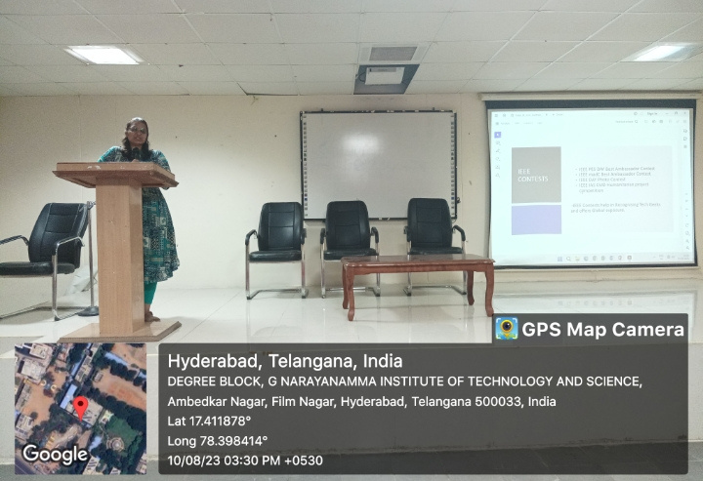

Slide 6
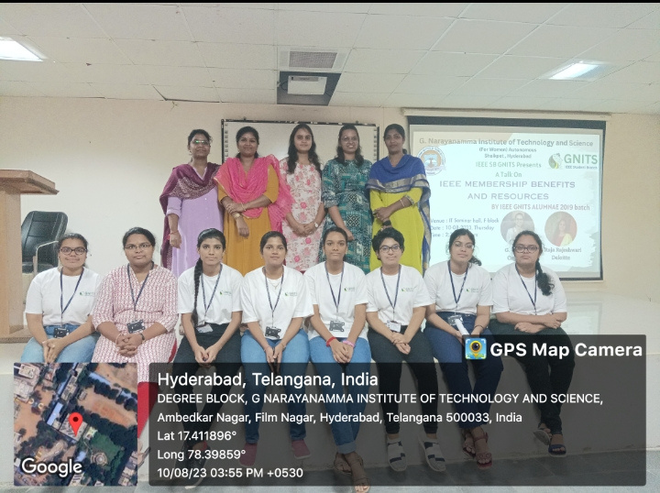

Slide 7

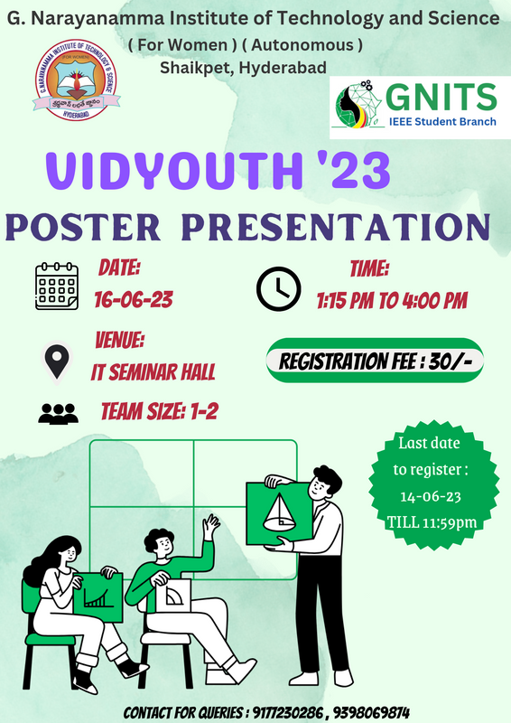
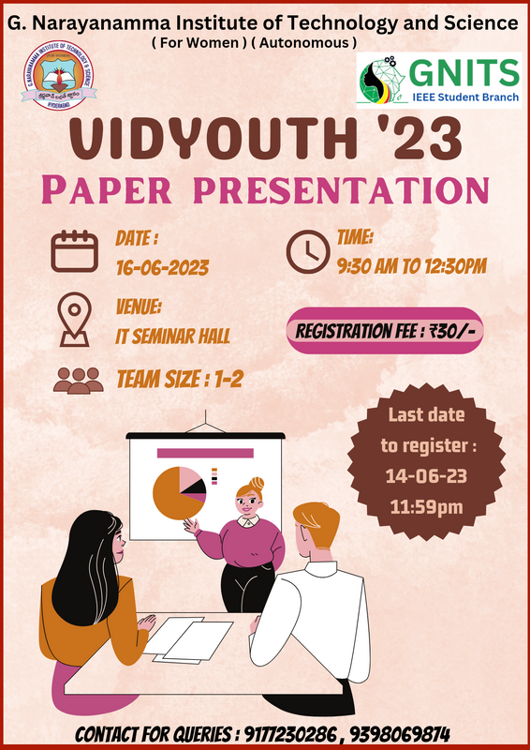

Slide 8
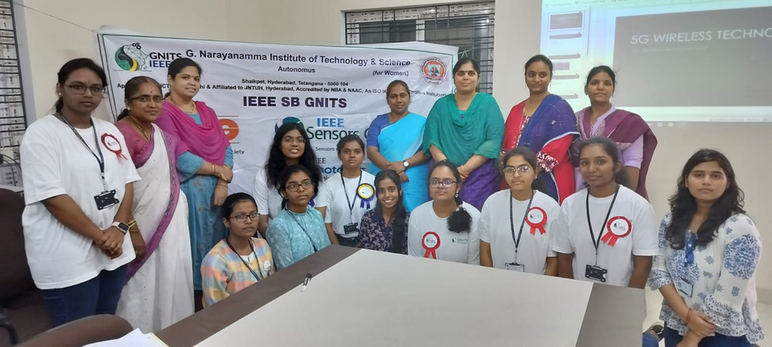
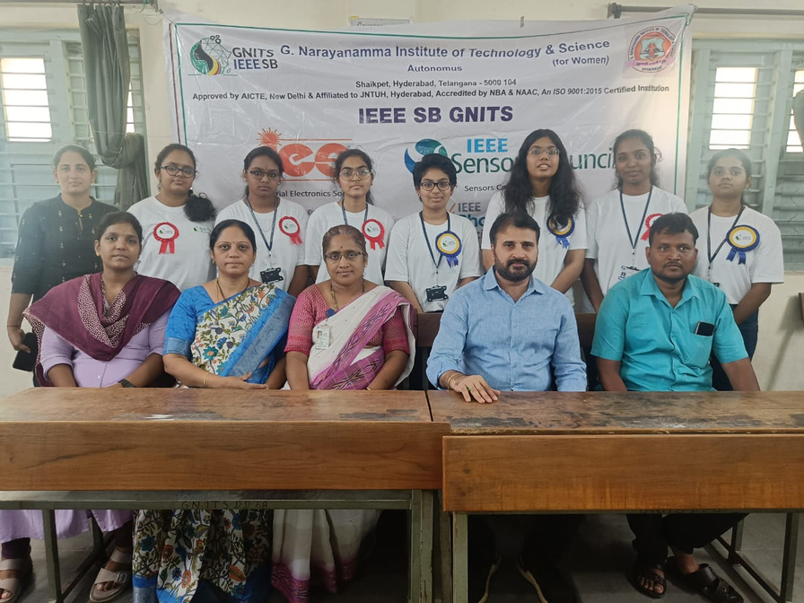
IEEE
Student
branch
GNITS

Slide 9
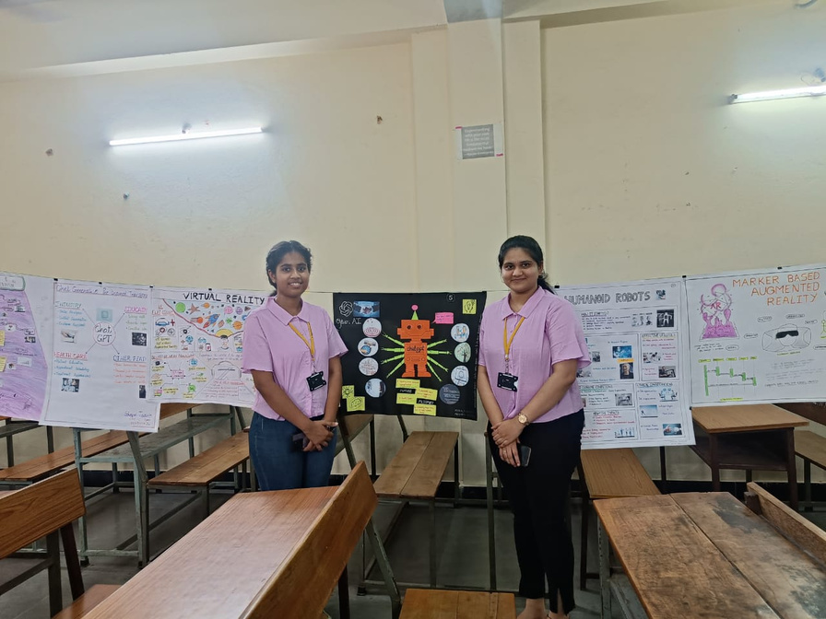
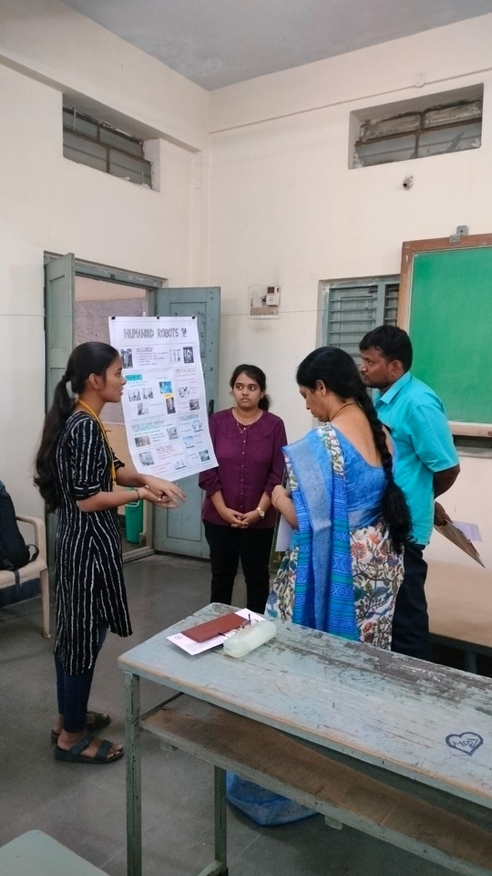
VIDYOUTH POSTER PRESENTATIONS

Slide 10
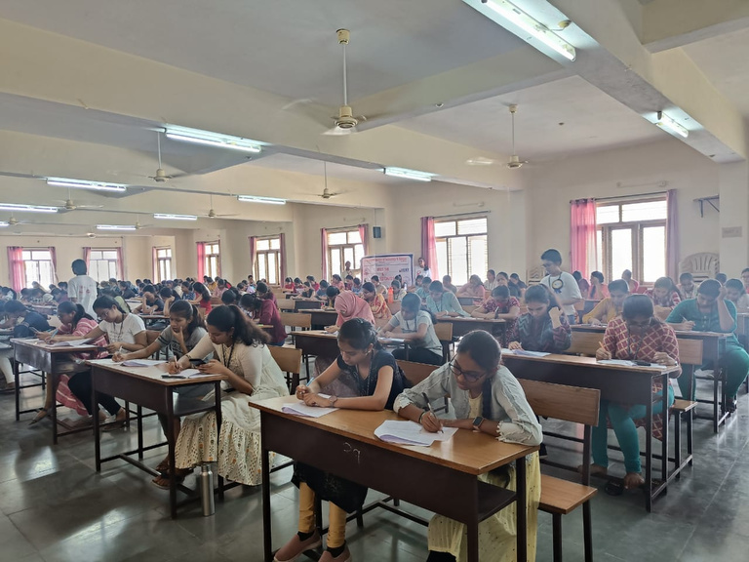
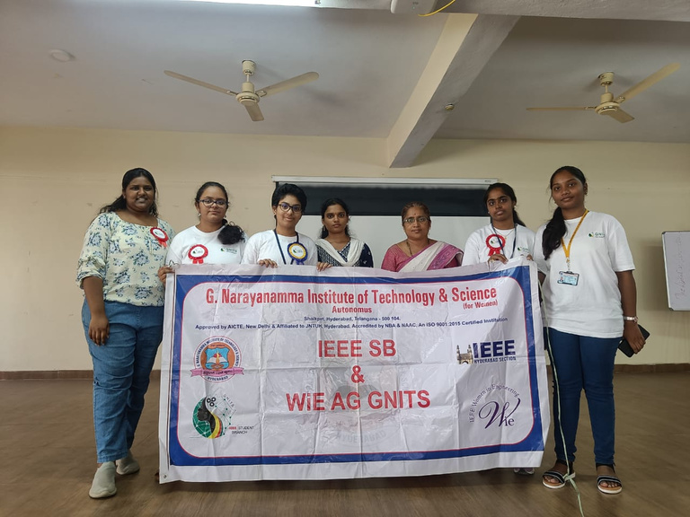
VIDYOUTH OLYMPIAD

Slide 11
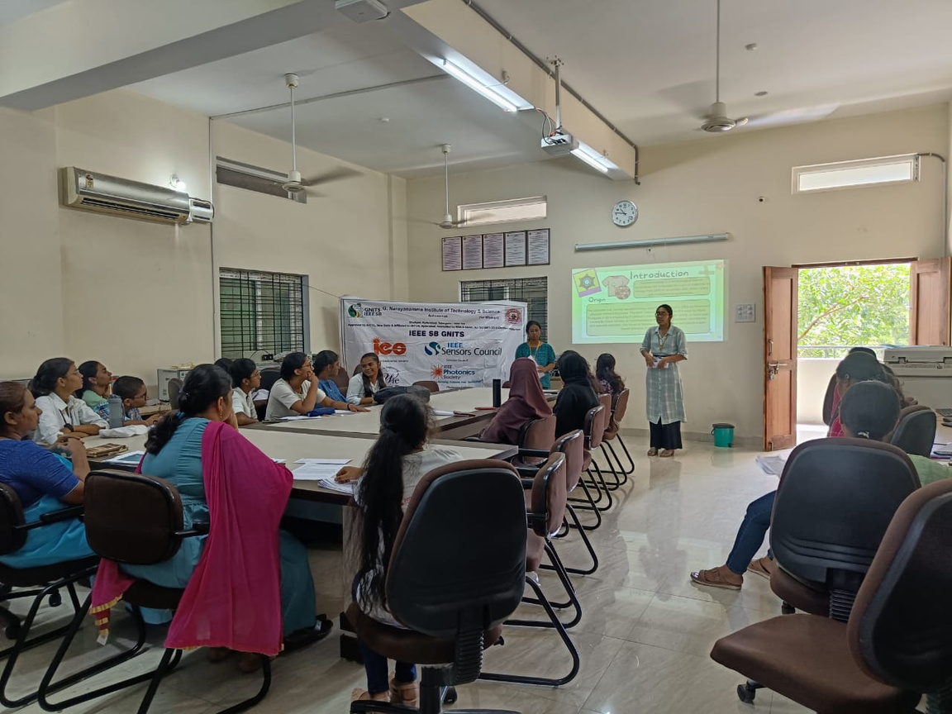
VIDYOUTH PAPER PRESENTATIONS

Slide 12


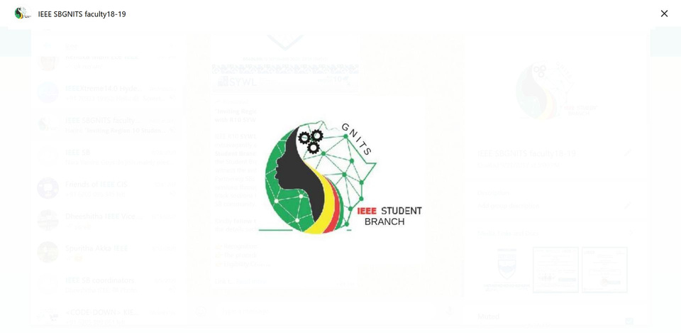


Reach us at
• • •
IEEE SB GNITS
Email : ieeesbgnits@gmail.com Instagram: @ieee_gnits

